Slide 1


Seasonal Agriculture Performance Analysis
Student Name: SHIVAM KUMAR
College: SUYASH INSTITUTE OF INFORMATION TECHNOLOGY GORAKHPUR
AICTE Student ID: STU6a1838239276c1779972131
9/2/2026
Annual Review
‹#›

Slide 2

PROBLEM STATEMENT
Agricultural performance changes from one season to another (Kharif, Rabi, Zaid) due to differences in rainfall, temperature, resource availability and market conditions.
Raw agricultural data does not clearly show how performance differs across seasons or what patterns exist within it.
The problem is to analyze the seasonal agriculture dataset and identify meaningful patterns, trends, relationships and variations in yield, cost and profitability.
Goal: support evidence-based, season-specific agricultural planning through data-driven insights.
9/2/2026
Annual Review
‹#›

Slide 3
Project Description
This project analyzes a dataset of 4,000 farm records across 8 Indian states, 8 crops and 3 cropping seasons – Kharif, Rabi and Zaid. It covers environmental conditions (rainfall, temperature, humidity, soil health), resource usage (irrigation, fertilizer, pesticide, water), and economic outcomes (yield, cost, revenue and profit).
Using Python-based data cleaning, exploratory analysis, statistical testing (ANOVA) and visualization, the project investigates how agricultural performance varies across seasons and derives evidence-based, season-specific planning recommendations.
9/2/2026
Annual Review
‹#›

Slide 4

WHO ARE THE END USERS?
Farmers – to plan crop choice, irrigation and resource use for the season ahead.
Agricultural policymakers – to design season-specific support schemes and subsidies.
Agri-businesses & insurers – to assess seasonal risk and plan crop insurance products.
Researchers & students – to study seasonal agricultural trends and build further models.
9/2/2026
Annual Review
‹#›

Slide 5

Technology Used
Python (Pandas, NumPy) – data cleaning and analysis
Matplotlib & Seaborn – data visualization
SciPy – statistical significance testing (ANOVA)
Jupyter Notebook – end-to-end documentation of the analysis
Microsoft PowerPoint – project presentation
9/2/2026
Annual Review
‹#›
Notes:
5

Slide 6
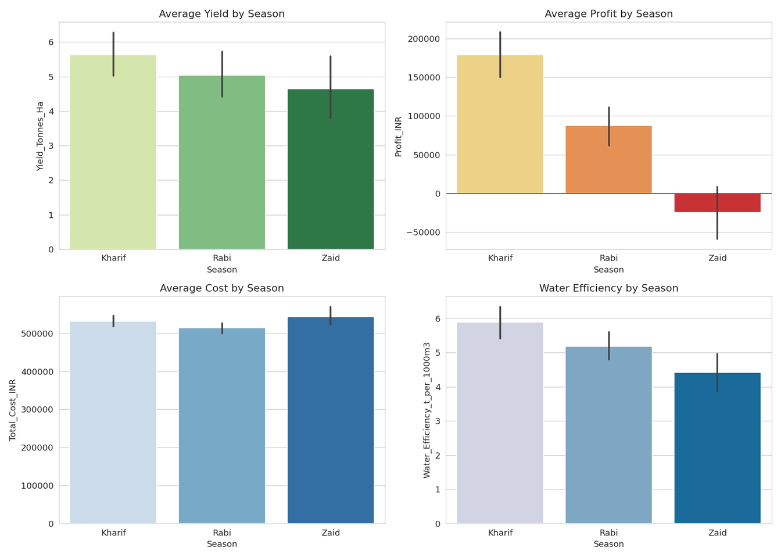
RESULTS
Seasonal KPIs: Yield, Profit, Cost & Water Efficiency
9/2/2026
Annual Review
‹#›

Slide 7
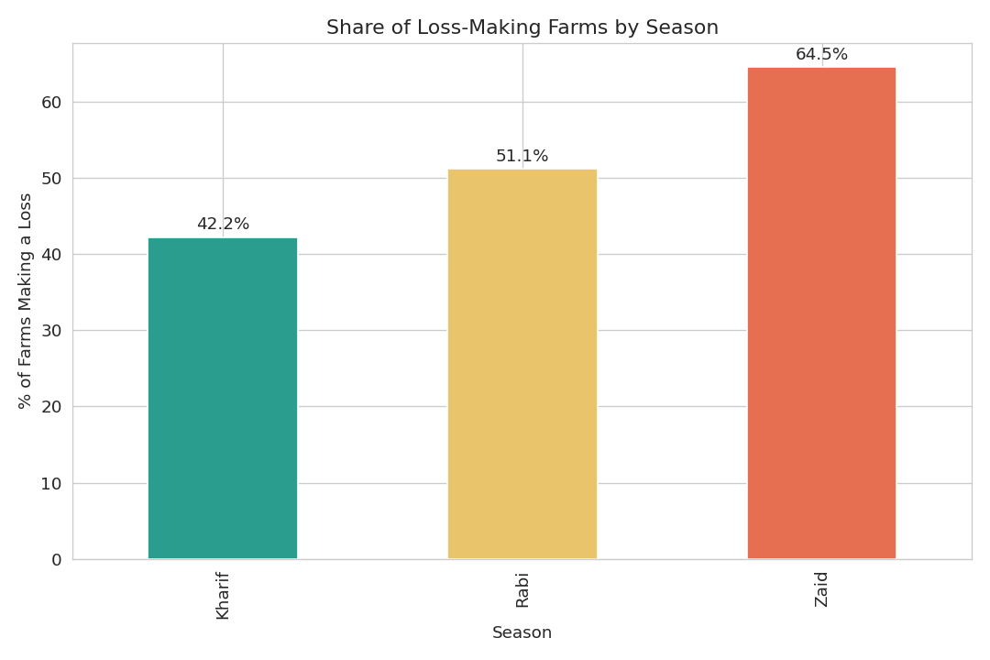
RESULTS
Share of Loss-Making Farms by Season
9/2/2026
Annual Review
‹#›

Slide 8
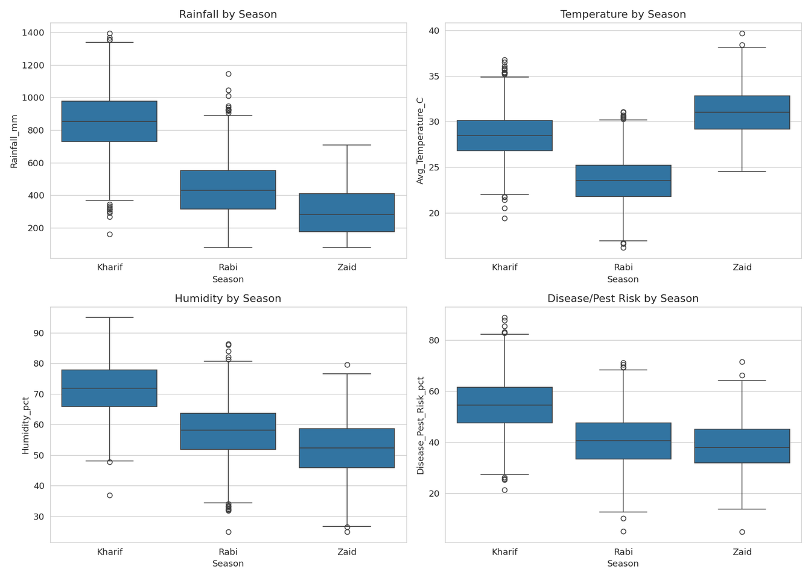
RESULTS
Environmental Conditions Across Seasons
9/2/2026
Annual Review
‹#›

Slide 9
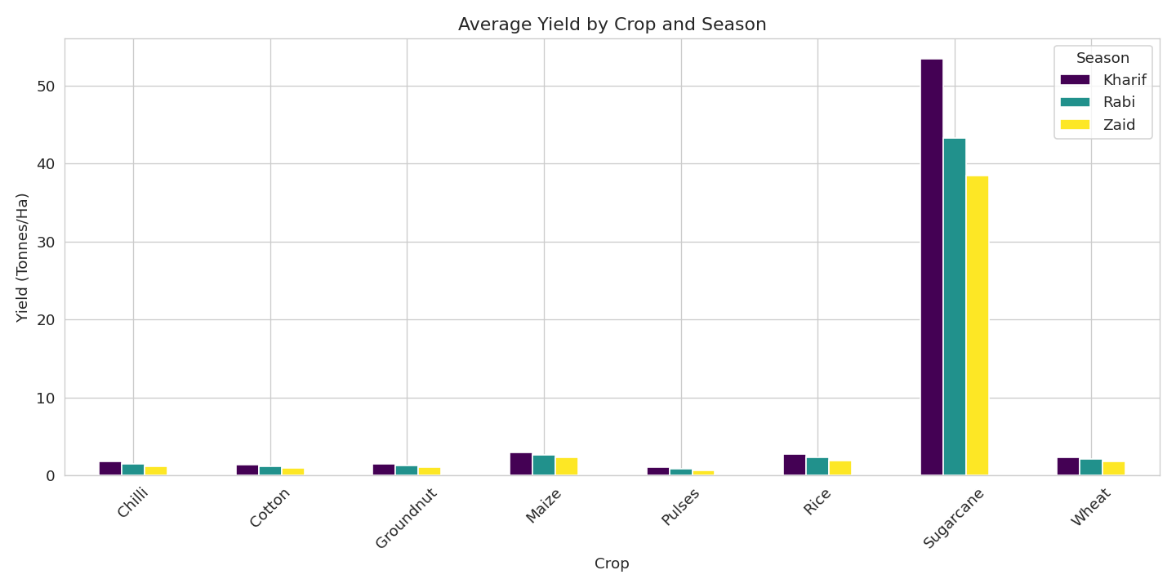
RESULTS
Crop-wise Average Yield by Season
9/2/2026
Annual Review
‹#›

Slide 10
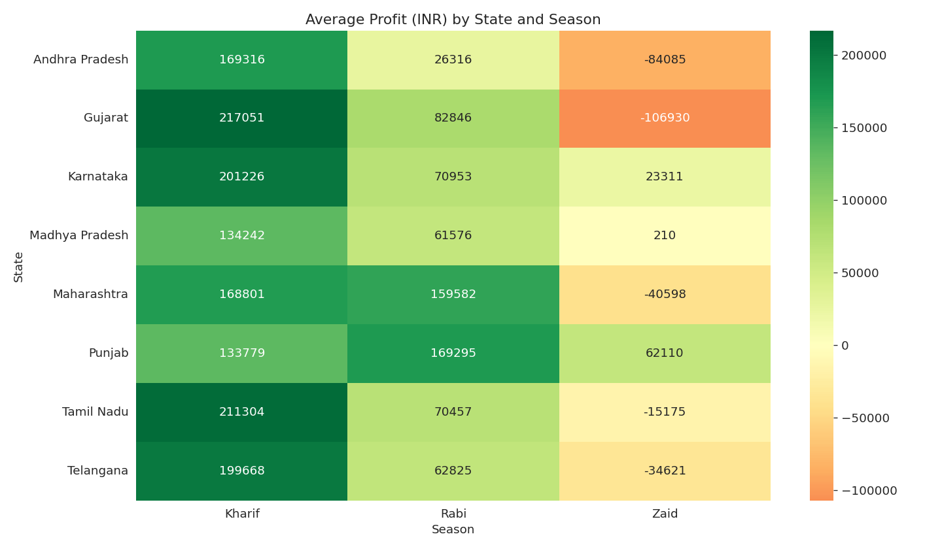
RESULTS
State-wise Average Profit (INR) by Season
9/2/2026
Annual Review
‹#›

Slide 11
Future scope
Extend the analysis with predictive modelling to forecast yield and profit for upcoming seasons.
Integrate real-time weather API data for more dynamic, up-to-date seasonal insights.
Add district-level drill-down analysis for finer, region-specific recommendations.
Build an interactive dashboard (Power BI / Streamlit) for easy use by farmers and policymakers.
Include multiple years of historical data to study year-over-year seasonal trends.
9/2/2026
Annual Review
‹#›

Slide 12
GitHub Link
https://github.com/shivamkofficial/Seasonal-Agriculture-Performance-Analysis
9/2/2026
Annual Review
‹#›

Slide 13

VOIS Course completion certificate -
Course name- Data Visualization
9/2/2026
Annual Review
‹#›

Slide 14
Thank you
.
.
9/2/2026
Annual Review
‹#›

